Slide 1
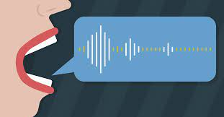
Speech Keyword Recognition
Joe Sangiolo and Ben Heinrich

Slide 2
Introduction
Train a model to identify spoken words from a finite set
Datasets:
Free Spoken Digit Dataset (FSDD)
Synthetic Speech Commands Dataset (SSCD)
Datasets contained folders of audio files of different people saying different words
FSDD: audio files for the digits 0-9
SSCD: audio files for more keywords, such as “bed” or “happy”
Project uses a finite set of words, but uses many audio files from many different people with different voices: creates a scalable model
Initial goal of working towards a voice assistant

Slide 3
Method
Our model is not trained to recognize or sound out new words, but to distinguish between words in a finite set
We chose to treat this as a classification problem
Approach:
Preprocess the data into spectrograms
Treat it as an image classification problem

Slide 4
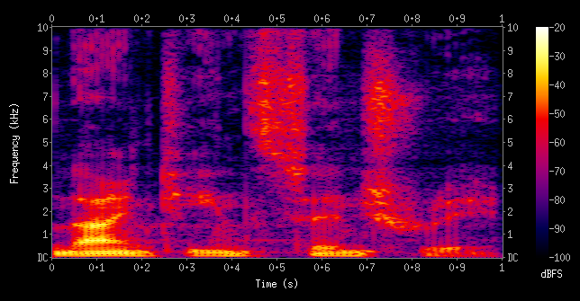
Example of a Spectrogram
Notes:
Spectrogram: a visualization of the frequency spectrum of a signal, where the frequency spectrum of a signal is the frequency range that is contained by the signal
Mel Spectrogram: Spectrogram converted to Mel scale (basic gist -> standardizes data to account for differences in pitch between voices)

Slide 5
Our Model
Convolutional Neural Network:
5x5 Conv2D layer
1 MaxPool2D layer
5x5 Conv2D layer
1 Flattening layer
1 Dense layer for outputs

Slide 6
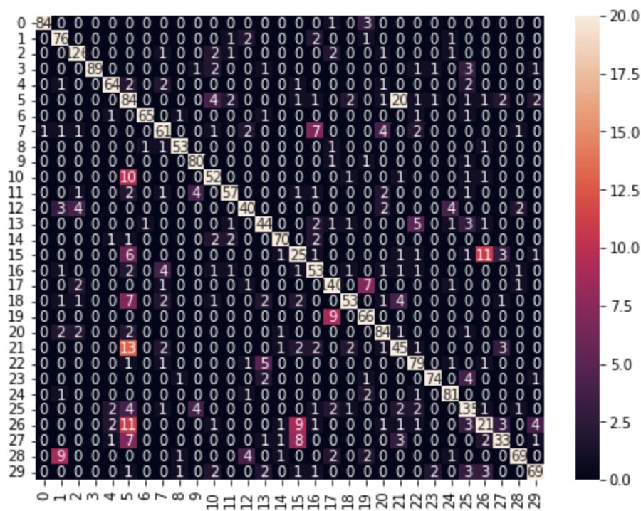
Evaluation
Our model consistently produced an accuracy above 72%
Many errors distinguishing between classes 5 (“on”) and 21 (“one”)
Lowest performers
5: “on”
15: “no”
21: “one”
26: “go”

Slide 7
Thank you!

